Slide 1

Malignant comment classifier Project PPT
Done by
Fenny Denny

Slide 2
Introduction
The proliferation of social media enables people to express their opinions widely online. However, at the same time, this has resulted in the emergence of conflict and hate, making online environments uninviting for users.
Comments ca be classified as :
Malignant
Non- malignant
Loathe
Rude
Abuse
Threat
Many celebrities and influences are facing backlashes from people and have to come across hateful and offensive comments. This can take a toll on anyone and affect them mentally leading to depression, mental illness, self-hatred and suicidal thoughts.

Slide 3
Objective
The objective of comment classifier model is:
Our goal is to build a prototype of online hate and abuse comment classifier which can used to classify hate and offensive comments so that it can be controlled and restricted from spreading hatred and cyberbullying

Slide 4
Scope of this project
It reduces the memory storage.
It increases security and controls.
It helps in reducing cyber bullying and backlashes.
It spreads positivity in the environment.

Slide 5
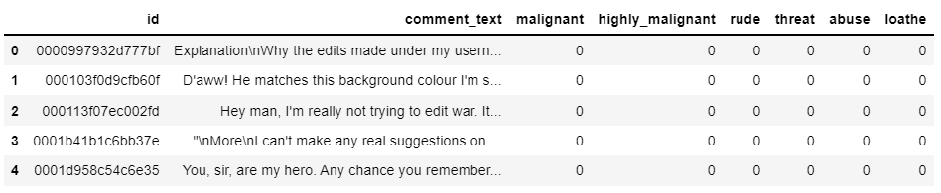
Dataset description
1. id : person who have written the comment is generalised by id.
2.comment_text : thoughts of person.
3. malignant : binary label which contains 0/1.
4.highly-malignant: binary label which contains 0/1.
5. rude: binary label which contains 0/1.
6. loathe: binary label which contains 0/1.
7. abuse : binary label which contains 0/1.
8. threat : binary label which contains 0/1.

Slide 6
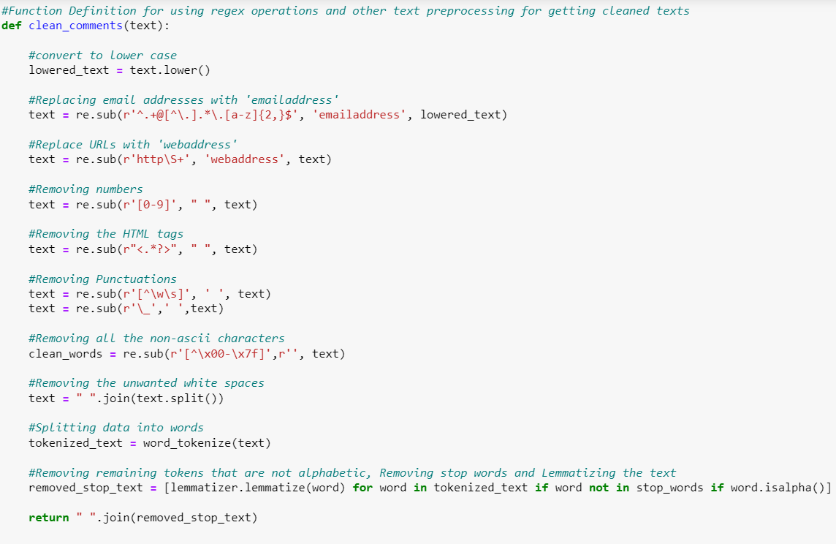
Data pre-processing
Converting lower case to upper case:
Text normalisation: it includes removing punctuation and symbols.

Slide 7
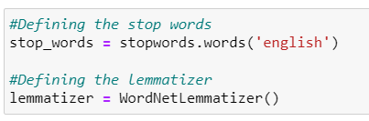
Stop words & lemmatisation

Slide 8
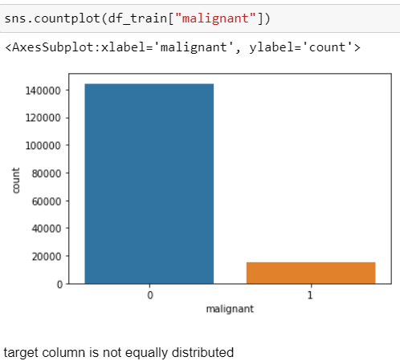
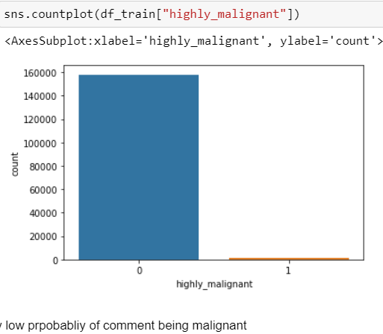
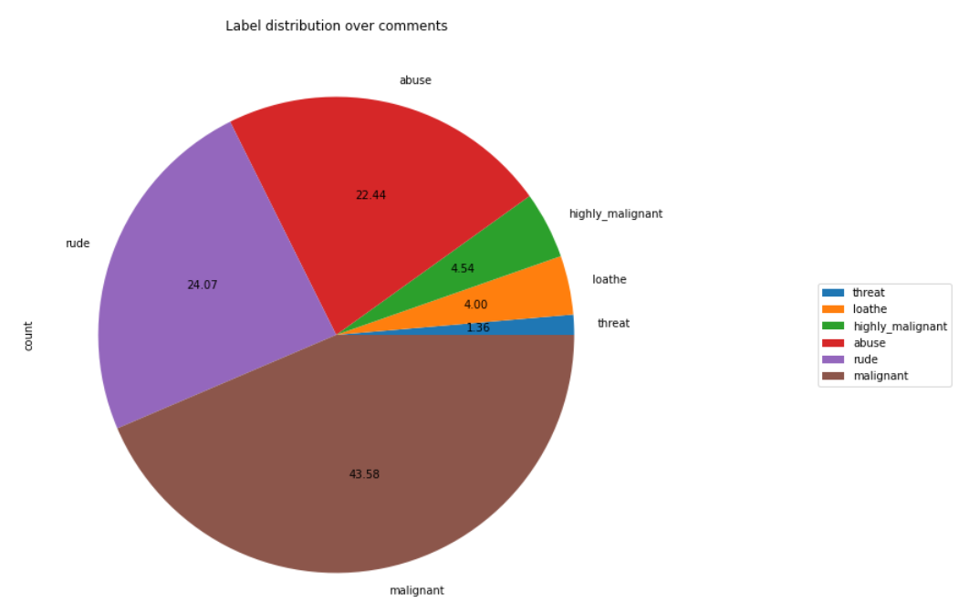
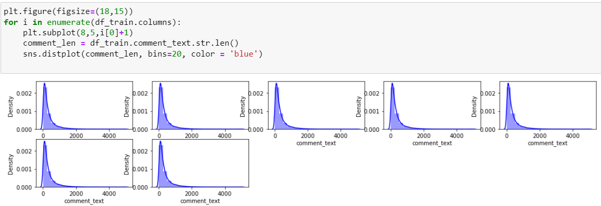
Visualisation

Slide 9
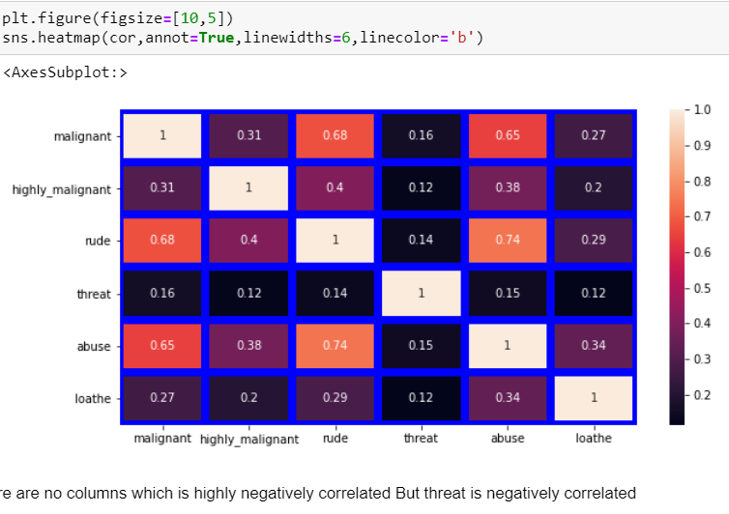
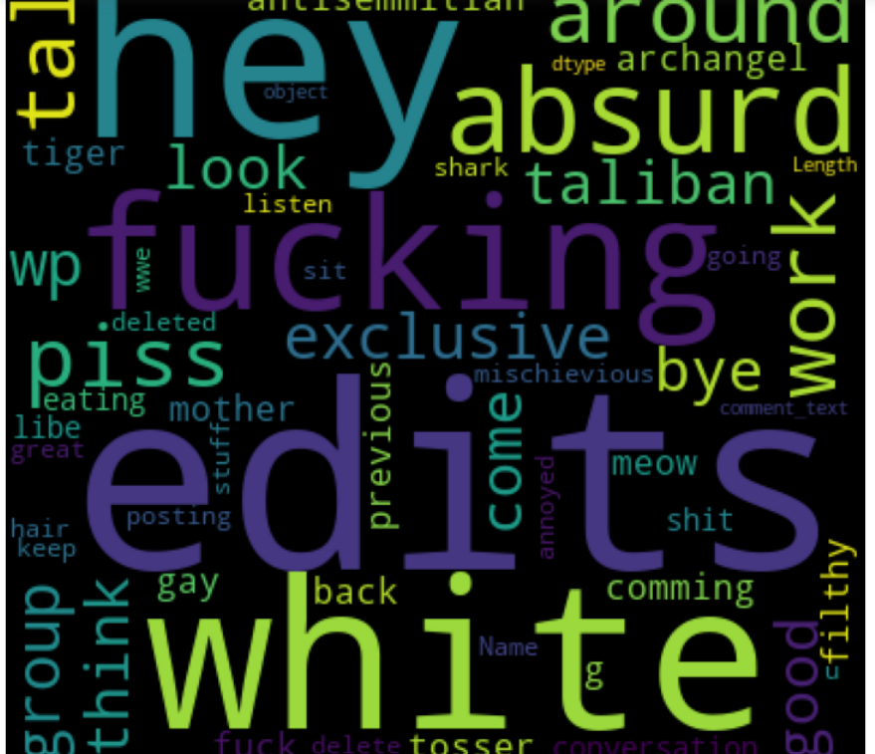
Visualisation

Slide 10

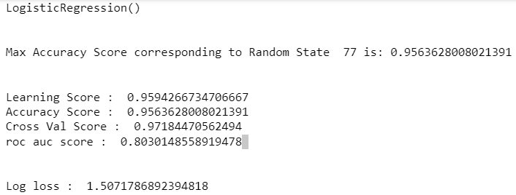
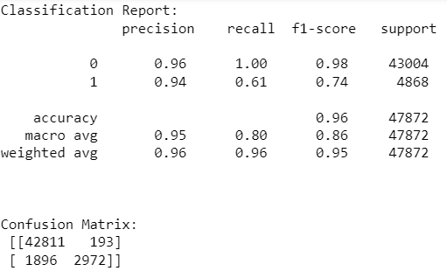
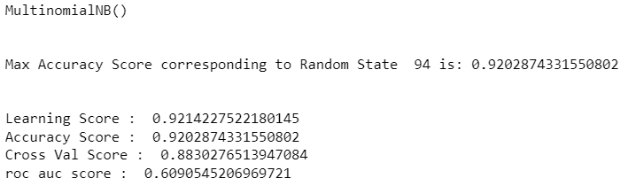
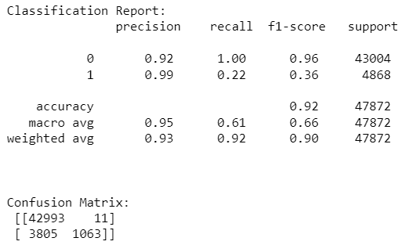
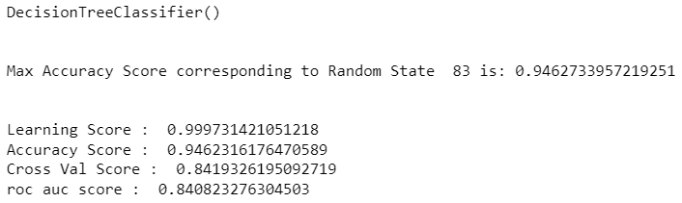
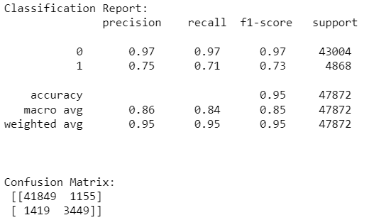
Model building

Slide 11
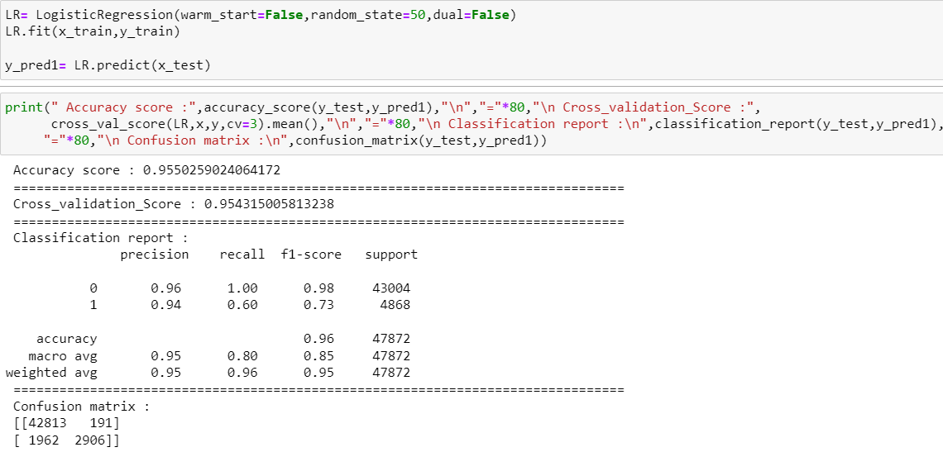
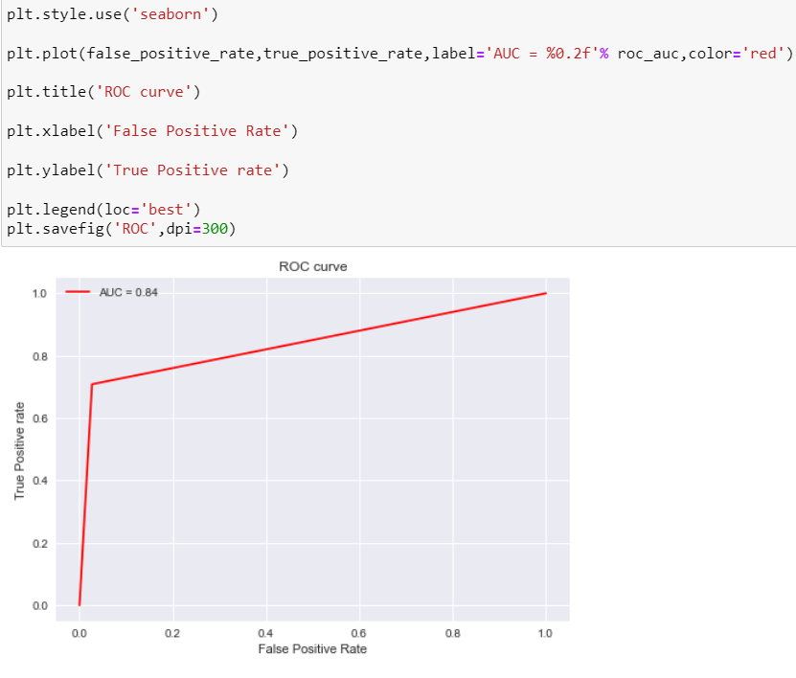
Hyperparameter tunning
Best model
Logistic regression

Slide 12
Conclusion
Communication is one of the basic necessities of everyone’s life. People need to talk and interact with one another to express what they think. Over the years, social media and social networking have been increasing exponentially due to an upsurge (rise) in the use of the internet. Flood of information arises from online conversation on a daily basis, as people are able to discuss, express themselves and express their opinion via these platforms. While this situation is highly productive and could contribute significantly to the quality of human life, it could also be destructive and enormously dangerous. The responsibility lies on the social media administration, or the host of organization to control and monitor these comments.
This research work focuses on developing a model that would automatically classify a comment as either malignant or non-malignant using logistic regression. Therefore, this study aims to develop a multi-headed model to detect different types of malignant comment like threats, rude, abusive, and loathe. By collecting and pre-processing malignant comments for training and testing using term frequency- inverse document frequency (TF-IDF) algorithm, developing a multi-headed model will detect different types of malignant comment using logistic regression to train the dataset, and evaluate the model using confusion metrics.

Slide 13


